Slide 1
Solving the Travelling Salesman Problem Using Phase Estimation
Group 5
盧弘偉 黃政勛 顏柏傑

Slide 2
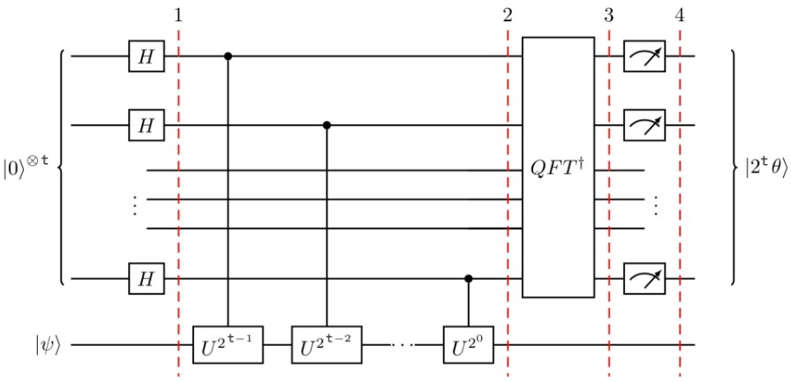
Quantum Phase Estimation
Corresponding quantum circuit :

Slide 3
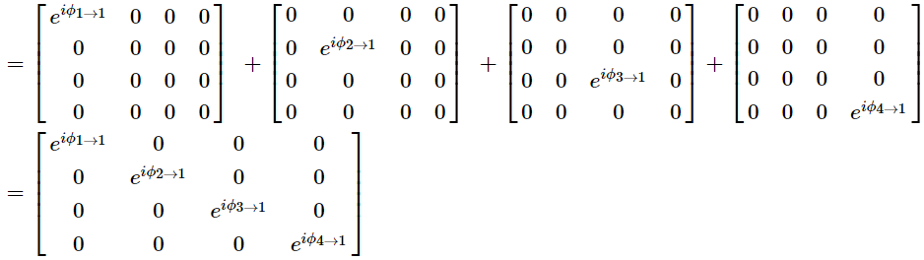

Build Unitary Matrix
$$Uj=\sum_{i=1}^{n}{\left(B\left[i\right]\left[j\right]×Outer product of i^{′}th basis vectors and itself\right)}$$
Example: j = 1.

Slide 4
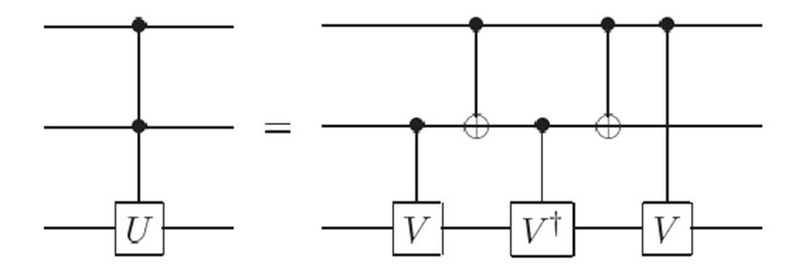
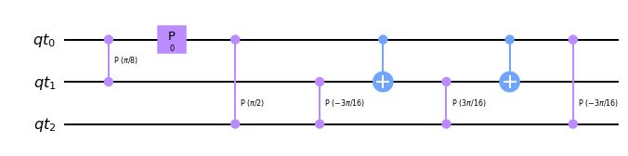
Implement of CU gate
Take U1 for example
Then make CU= CU1 ⊗ CU2 ⊗ CU3 ⊗ CU4.

Slide 5
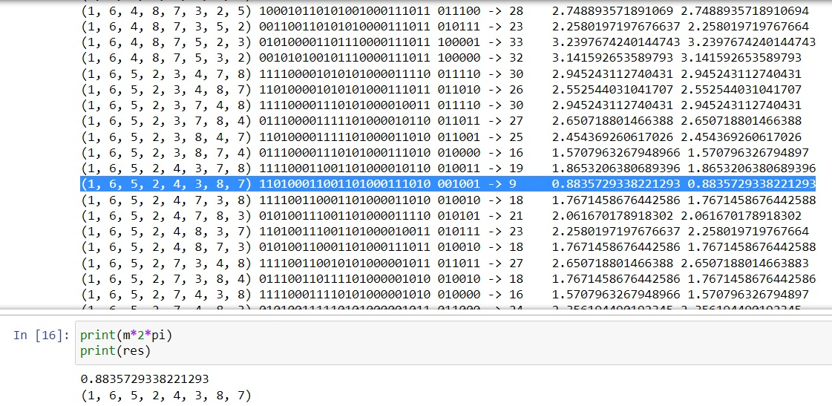
Case of 8 Vertices/Cities
path eigen state phase distance check

Slide 6
Observation
1. Require a huge amount of qubits
e.g. n = 4, counting bits = 6 : total qubits = 4*log2(4) + 6 = 14
Total qubits ∝ n*log2(n), n : # of vertices/cities
max. number of qubits in real device = 5
2. The annoying order of qubits in Qiskit
3. Still NP-complete
One of the advantages of using quantum approach is matrix multiplication; however, in this case the only matrix we have is the eigenvalue matrix, which is a diagonal matrix.
Therefore, we didn’t take any advantage of quantum approach.

